Slide 1
Determining Density from a Graph

Slide 2
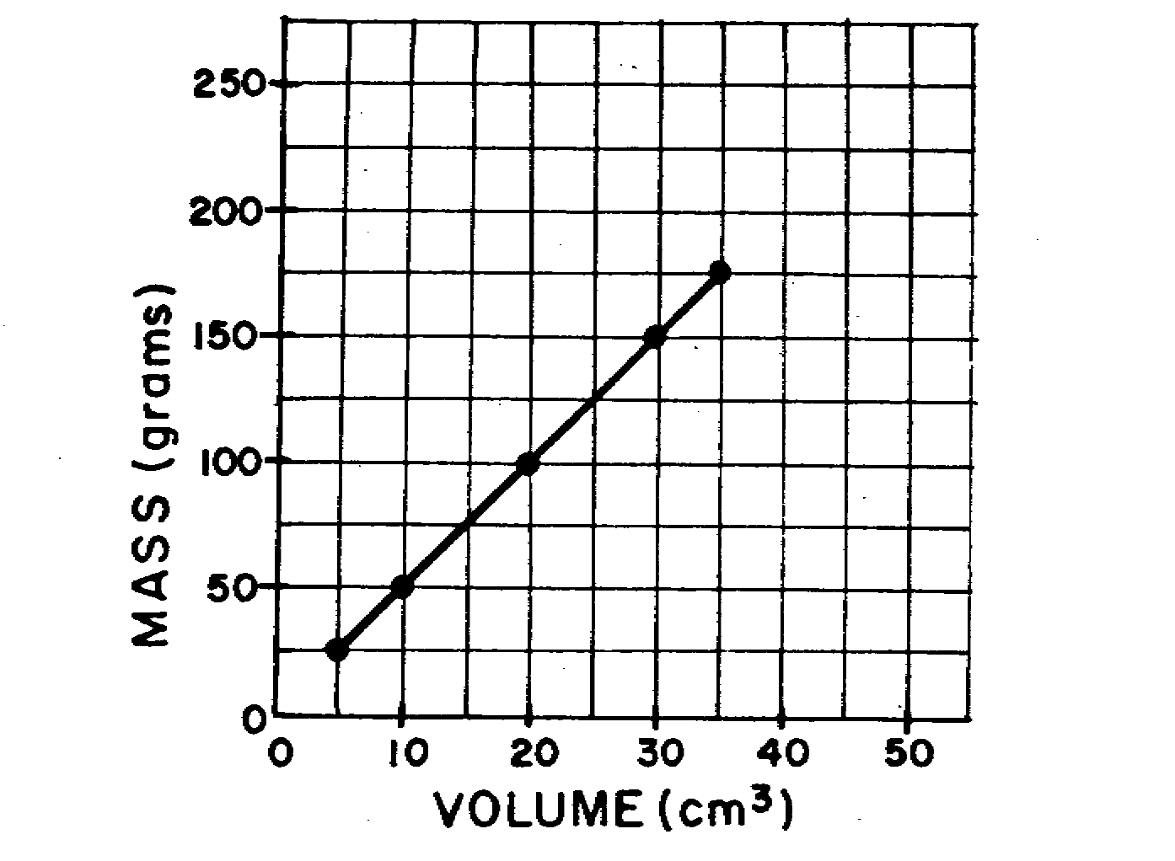
Example:
Calculate the slope of this line.
2 points: (35,175) and (10, 50)
Calculate rise: 175g-50g = 125g
Calculate run: 35 cm³ – 10cm³ = 25cm³
Calculate slope: 125g/25cm³ = 5g/cm³
Therefore slope represents the density!

Slide 3
Instructions
Using the graph given, calculate the slope for all metals.
Choose one of the three objects. Create an observation table to record the qualitative and quantitative information and record.
Calculate density of your object.
Based on your observations and the graph, identify the material.
Write a conclusion to support your decision.
Always show your work.
Sample | Qualitative Observation s | Mass (g) | Volume (mL)
Object # 1

